Slide 1
Neural Networks

Slide 2
Contents
Introduction
Simple Mathematical Model
What a Perceptron Can Do?
What a Neural Network Can Do?
Multilayer Perceptron
Error Back Propagation
Generalization and Overfitting
Advanced Topics
Concluding Remarks

Slide 3






Example of Error Back Propagation (1)
Example : XOR
Hidden nodes : 2
Learning rate : 0.5
$$w_{ji}$$
$$w_{kj}$$
w₁₁
$x_{n1}$ | $$x_{n2}$$ | $t_{n1}$
1 | 1 | 0
1 | 0 | 1
0 | 1 | 1
0 | 0 | 0
$$x_{n1}$$
w₁₂
w₁₁
w₁₃
w₂₁
w₁₂
$$x_{n2}$$
w₂₂
$$o_{n1}$$
w₂₃
w₁₃
1
1

Slide 4
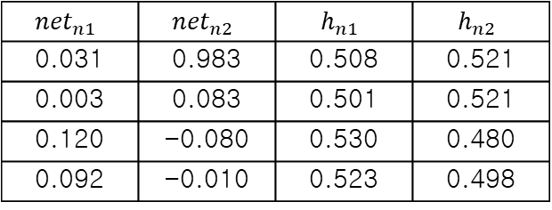




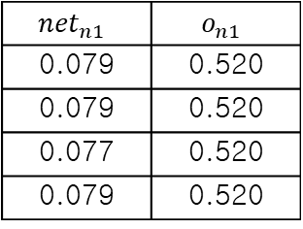





Example of Error Back Propagation (2)
Example : XOR
$$x_{n1}$$
-0.089
0.098
0.056
0.028
$$x_{n2}$$
0.067
$$o_{n1}$$
-0.07
0.092
0.016
-0.01
1
1
$${net}_{nj}$$
$$h_{nj}$$
$${net}_{nk}$$
$$o_{nk}$$
$n$
1
2
3
4
$x_{n1}$ | $$x_{n2}$$ | $t_{n1}$
1 | 1 | 0
1 | 0 | 1
0 | 1 | 1
0 | 0 | 0
$${net}_{n1}$$ | $${net}_{n2}$$ | $$h_{n1}$$ | $$h_{n2}$$
0.031 | 0.983 | 0.508 | 0.521
0.003 | 0.083 | 0.501 | 0.521
0.120 | -0.080 | 0.530 | 0.480
0.092 | -0.010 | 0.523 | 0.498
$${net}_{n1}$$ | $$o_{n1}$$
0.079 | 0.520
0.079 | 0.520
0.077 | 0.520
0.079 | 0.520

Slide 5

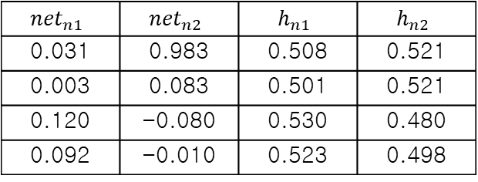


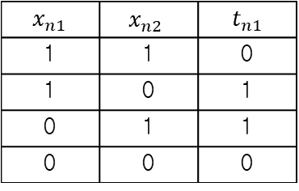


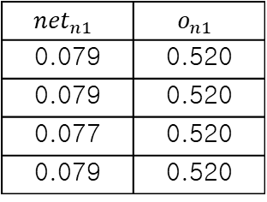

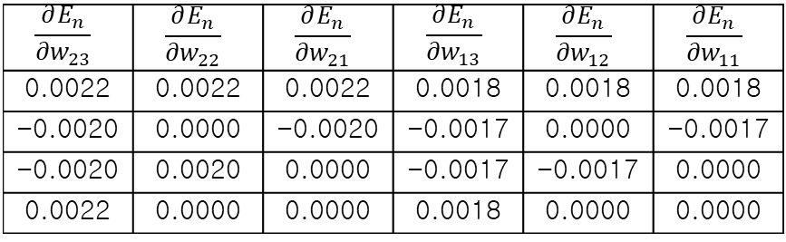

Example of Error Back Propagation (3)
Example : XOR
$${net}_{nj}$$
$$h_{nj}$$
$${net}_{nk}$$
$$o_{nk}$$
$n$
1
2
3
4
$x_{n1}$ | $$x_{n2}$$ | $t_{n1}$
1 | 1 | 0
1 | 0 | 1
0 | 1 | 1
0 | 0 | 0
$${net}_{n1}$$ | $${net}_{n2}$$ | $$h_{n1}$$ | $$h_{n2}$$
0.031 | 0.983 | 0.508 | 0.521
0.003 | 0.083 | 0.501 | 0.521
0.120 | -0.080 | 0.530 | 0.480
0.092 | -0.010 | 0.523 | 0.498
$${net}_{n1}$$ | $$o_{n1}$$
0.079 | 0.520
0.079 | 0.520
0.077 | 0.520
0.079 | 0.520
$n$
1
2
3
4
$$\frac{∂E_{n}}{{∂w}_{13}}$$ | $$\frac{∂E_{n}}{{∂w}_{12}}$$ | $$\frac{∂E_{n}}{{∂w}_{11}}$$
0.1298 | 0.0676 | 0.0659
-0.1199 | -0.0624 | -0.0600
-0.1200 | -0.0576 | -0.0636
0.1297 | 0.0645 | 0.0678
$$\frac{∂E_{n}}{{∂w}_{23}}$$ | $$\frac{∂E_{n}}{{∂w}_{22}}$$ | $$\frac{∂E_{n}}{{∂w}_{21}}$$ | $$\frac{∂E_{n}}{{∂w}_{13}}$$ | $$\frac{∂E_{n}}{{∂w}_{12}}$$ | $$\frac{∂E_{n}}{{∂w}_{11}}$$
0.0022 | 0.0022 | 0.0022 | 0.0018 | 0.0018 | 0.0018
-0.0020 | 0.0000 | -0.0020 | -0.0017 | 0.0000 | -0.0017
-0.0020 | 0.0020 | 0.0000 | -0.0017 | -0.0017 | 0.0000
0.0022 | 0.0000 | 0.0000 | 0.0018 | 0.0000 | 0.0000

Slide 6
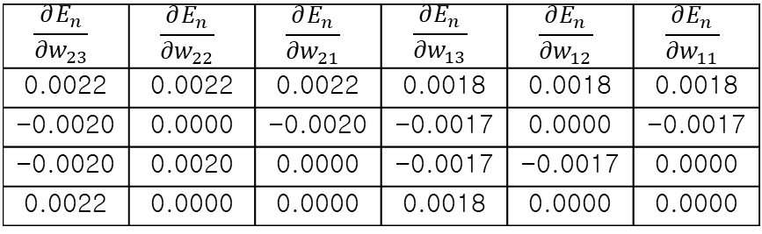



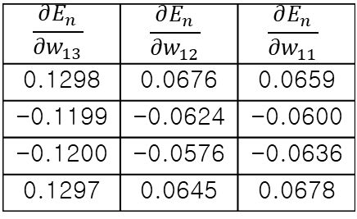
Example of Error Back Propagation (4)
Example : XOR
$n$
1
2
3
4
$$\frac{∂E_{n}}{{∂w}_{13}}$$ | $$\frac{∂E_{n}}{{∂w}_{12}}$$ | $$\frac{∂E_{n}}{{∂w}_{11}}$$
0.1298 | 0.0676 | 0.0659
-0.1199 | -0.0624 | -0.0600
-0.1200 | -0.0576 | -0.0636
0.1297 | 0.0645 | 0.0678
$$\frac{∂E_{n}}{{∂w}_{23}}$$ | $$\frac{∂E_{n}}{{∂w}_{22}}$$ | $$\frac{∂E_{n}}{{∂w}_{21}}$$ | $$\frac{∂E_{n}}{{∂w}_{13}}$$ | $$\frac{∂E_{n}}{{∂w}_{12}}$$ | $$\frac{∂E_{n}}{{∂w}_{11}}$$
0.0022 | 0.0022 | 0.0022 | 0.0018 | 0.0018 | 0.0018
-0.0020 | 0.0000 | -0.0020 | -0.0017 | 0.0000 | -0.0017
-0.0020 | 0.0020 | 0.0000 | -0.0017 | -0.0017 | 0.0000
0.0022 | 0.0000 | 0.0000 | 0.0018 | 0.0000 | 0.0000
$$\frac{∂E}{∂w}=\sum_{n=1}^{N}{\frac{∂E_{n}}{∂w}}$$
$$\frac{∂E}{∂w}=\sum_{n=1}^{N}{\frac{∂E_{n}}{∂w}}$$
0.0196 | 0.0120 | 0.0101
0.0003 | 0.0002 | 0.0002 | 0.0003 | 0.0001 | 0.0001

Slide 7








Example of Error Back Propagation (5)
Example : XOR
$$\frac{∂E}{{∂w}_{13}}$$ | $$\frac{∂E}{{∂w}_{12}}$$ | $$\frac{∂E}{{∂w}_{11}}$$
$$\frac{∂E}{{∂w}_{23}}$$ | $$\frac{∂E}{{∂w}_{22}}$$ | $$\frac{∂E}{{∂w}_{21}}$$ | $$\frac{∂E}{{∂w}_{13}}$$ | $$\frac{∂E}{{∂w}_{12}}$$ | $$\frac{∂E}{{∂w}_{11}}$$
0.0196 | 0.0120 | 0.0101
0.0003 | 0.0002 | 0.0002 | 0.0003 | 0.0001 | 0.0001
$$w^{t+1}=w^{t}−η\frac{∂E}{∂w}$$
$$x_{n1}$$
-0.089
$$x_{n1}$$
-0.0890
0.098
0.056
0.0929
0.0509
0.028
0.0279
$$x_{n2}$$
0.067
$$o_{n1}$$
$$x_{n2}$$
0.0610
$$o_{n1}$$
-0.07
-0.0701
0.092
0.016
0.0918
0.0062
-0.01
-0.0101
1
1
1
1

Slide 8






Example of Error Back Propagation (6)
Example : XOR
Iteration : 0
Iteration : 1000
$x_{n1}$ | $$x_{n2}$$ | $t_{n1}$ | $$o_{n1}$$
1 | 1 | 0 | 0.52
1 | 0 | 1 | 0.50
0 | 1 | 1 | 0.52
0 | 0 | 0 | 0.55
$x_{n1}$ | $$x_{n2}$$ | $t_{n1}$ | $$o_{n1}$$
1 | 1 | 0 | 0.50
1 | 0 | 1 | 0.48
0 | 1 | 1 | 0.50
0 | 0 | 0 | 0.52
$$x_{n1}$$
-0.089
$$x_{n1}$$
-0.43
0.098
0.056
0.08
-0.014
0.028
-0.29
$$x_{n2}$$
0.067
$$o_{n1}$$
$$x_{n2}$$
-0.06
$$o_{n1}$$
-0.07
-0.06
0.092
0.016
-0.68
0.019
-0.01
-0.72
1
1
1
1

Slide 9


Example of Error Back Propagation (7)
Example : XOR
Iteration : 2000
Iteration : 3000
$x_{n1}$ | $$x_{n2}$$ | $t_{n1}$ | $$o_{n1}$$
1 | 1 | 0 | 0.53
1 | 0 | 1 | 0.48
0 | 1 | 1 | 0.50
0 | 0 | 0 | 0.48
$x_{n1}$ | $$x_{n2}$$ | $t_{n1}$ | $$o_{n1}$$
1 | 1 | 0 | 0.30
1 | 0 | 1 | 0.81
0 | 1 | 1 | 0.81
0 | 0 | 0 | 0.11
$$x_{n1}$$
-0.57
$$x_{n1}$$
-2.39
0.11
0.093
-2.35
4.79
-1.10
-5.86
$$x_{n2}$$
-1.01
$$o_{n1}$$
$$x_{n2}$$
-6.18
$$o_{n1}$$
-0.97
-5.19
-1.07
0.12
3.15
-1.68
-0.94
1.44
1
1
1
1

Slide 10


Example of Error Back Propagation (8)
Example : XOR
Iteration : 5000
Iteration : 10000
$x_{n1}$ | $$x_{n2}$$ | $t_{n1}$ | $$o_{n1}$$
1 | 1 | 0 | 0.05
1 | 0 | 1 | 0.96
0 | 1 | 1 | 0.96
0 | 0 | 0 | 0.03
$x_{n1}$ | $$x_{n2}$$ | $t_{n1}$ | $$o_{n1}$$
1 | 1 | 0 | 0.02
1 | 0 | 1 | 0.98
0 | 1 | 1 | 0.98
0 | 0 | 0 | 0.02
$$x_{n1}$$
-4.15
$$x_{n1}$$
-4.67
-4.11
8.34
-4.63
9.59
-6.38
-6.63
$$x_{n2}$$
-8.57
$$o_{n1}$$
$$x_{n2}$$
-9.73
$$o_{n1}$$
-6.09
-6.39
6.09
3.86
6.91
-4.53
2.38
2.63
1
1
1
1

Slide 11
Example of Error Back Propagation (9)
Example : XOR
Error graph

Slide 12
Example of Error Back Propagation (10)
Example2 :
Hidden nodes : 4
Iteration : 500,000
Learning rate : 0.7
Input | Output
0.00 | 0.00
0.10 | 0.36
0.20 | 0.64
0.30 | 0.84
0.40 | 0.96
0.50 | 1.00
0.60 | 0.96
0.70 | 0.84
0.80 | 0.64
0.90 | 0.36
1.00 | 0.00
f(x) = 4x*(1-x)
1
0
.5
1

Slide 13
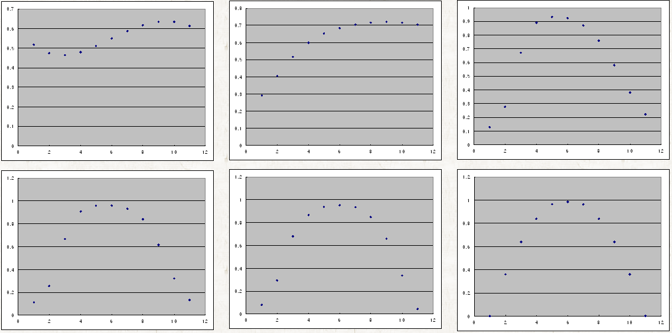
Example of Error Back Propagation (11)
Example2

Slide 14
Generalization and Overfitting (1)
We gave only 11 points
A NN learned only that 11 points
Can the NN answer to the un-learned points?
Training data
Training result

Slide 15
Generalization and Overfitting (2)
Yes, NNs generalize what they have learned
1
0
.5
1

Slide 16
Generalization and Overfitting (3)
Which one is better?
Training data

Slide 17
Generalization and Overfitting (4)
To increase generalization accuracy
Find the optimal number of neurons
Find the optimal number of training iterations
Use regularization
Use more training data

Slide 18
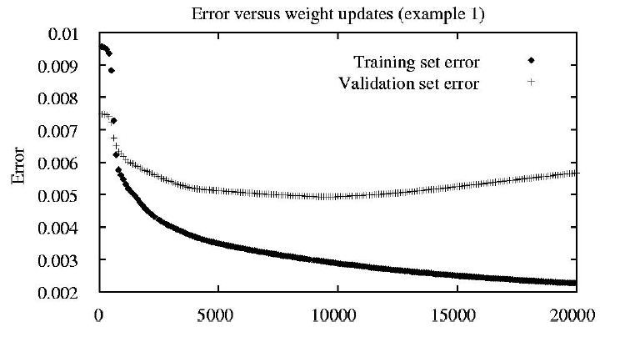
Generalization and Overfitting (5)

